Slide 1


Slide 2
Term | Definition
Business | Commercial activities for profit.
Analytics | Analysis of data for insights.
Business Analytics | Data-driven decision-making in business.
Terms

Slide 3
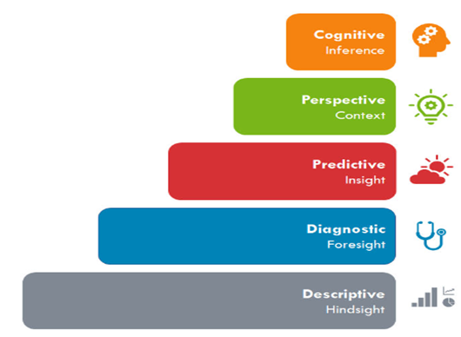
Types of Analytics
Cognitive analytics : What can be improved or automate ? Related with automation /intelligence
Prescriptive analytics : What should be done ? Suggests a course of action.
Predictive analytics : What will happen ? Moves to what is likely going to happen in the near term.
Diagnostic analytics : Why did happen ? Focuses more on why something happened.
Descriptive analytics : What happened ? Describes what has happened over a given period.

Slide 4
Business Analytics Requires :
Technical Skills
Analytical Skills
Business Knowledge
Project Management Skills
Communication / Soft Skills

Slide 5
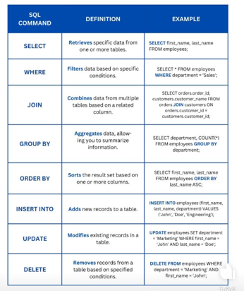
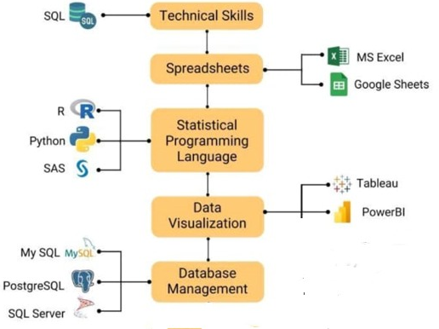
1. Technical Skills

Slide 6
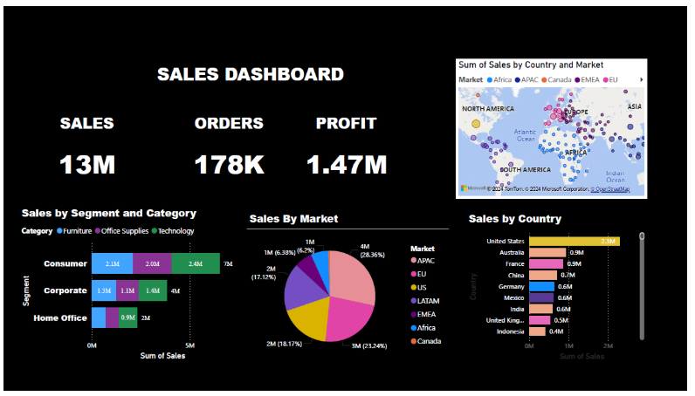
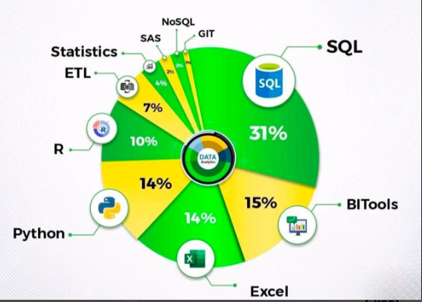
1. Technical Skills:

Slide 7
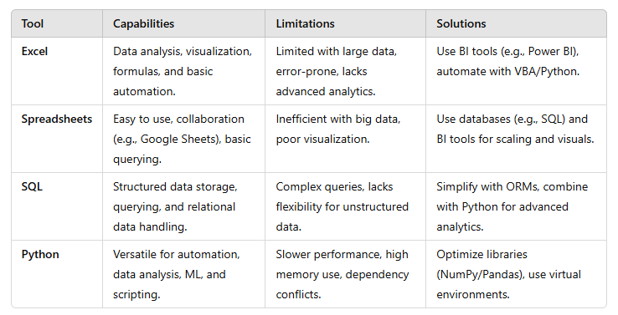
Capabilities , Limitations & Solutions

Slide 8
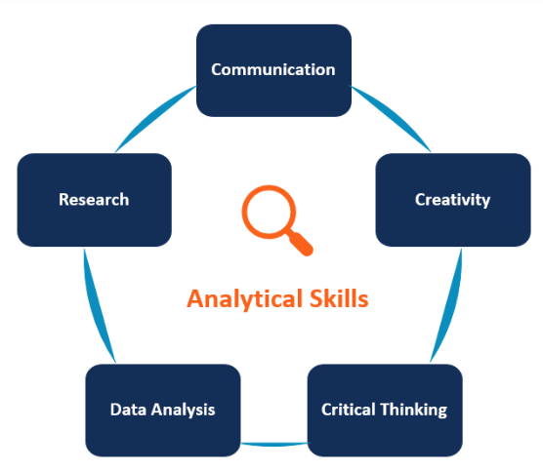

2. Analytical Skills

Slide 9
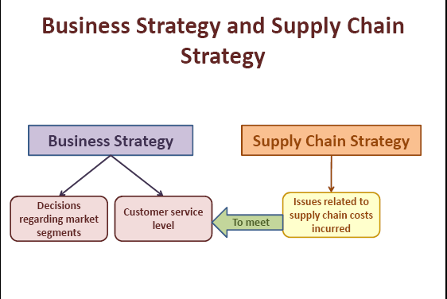

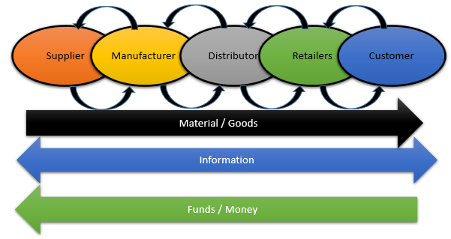
3. Business Knowledge
Domain Expertise: Knowledge of the industry or business area (e.g., finance, marketing, supply chain).
Strategic Thinking: Understanding how analytics aligns with overall business strategy.
Market Research: Analyzing market trends and customer behavior to inform decision-making.
Demand
Supply
Alliance
Creating Strategic Fit

Slide 10
Supply Chain Management (SCM) Definition
3. Business Knowledge
Management of the Flow of
Material, Information and Funds
from beginning to the end
in any organization is called
Supply Chain Management
In short SCM Means :
“Planning , Coordination & Strategy Making”
Or
Using 7C’s : Connect , Create , Customize , Coordinate, Consolidate , Collaborate & Contribute

Slide 11
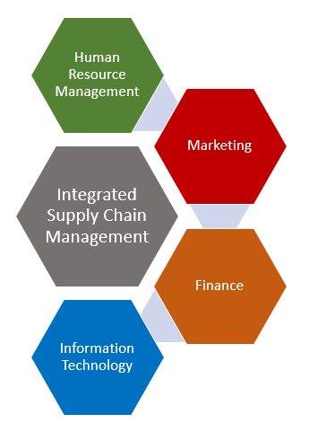
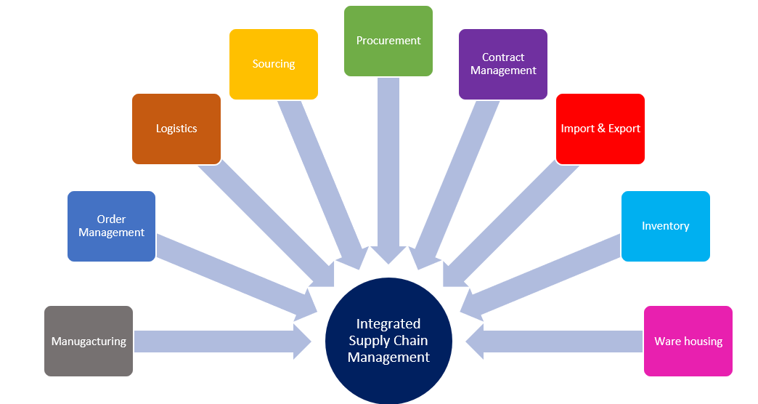
3. Business Knowledge
Integrated Supply Chain Management (Functional View)
Direct Relationships /Direct Functions
Indirect Relationships / Supportive Functions

Slide 12
Tools and Technologies Used in Supply Chains
3. Business Knowledge
Data Analytics Platforms: Tools like Tableau or Power BI enable visualization of trends and anomalies.
Supply Chain Management Software: Solutions like SAP and Oracle provide comprehensive insights into operations.
Artificial Intelligence (AI): AI algorithms can predict and identify root causes of disruptions.
Internet of Things (IoT): IoT devices provide real-time data on inventory, transport, and equipment.
Collaboration Tools: Platforms like Slack or Microsoft Teams streamline communication

Slide 13
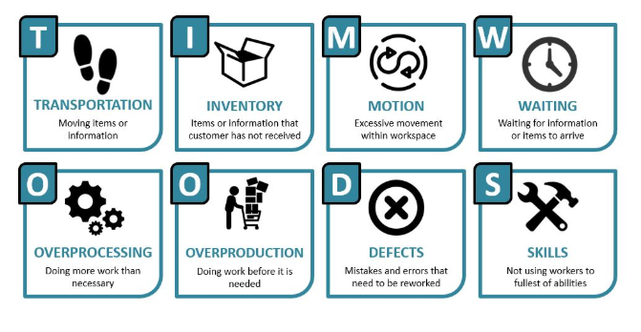
TIMWOODS
3. Business Knowledge
“Common Supply Chain Challenges”
How can we reduce the cost of Business Process?

Slide 14
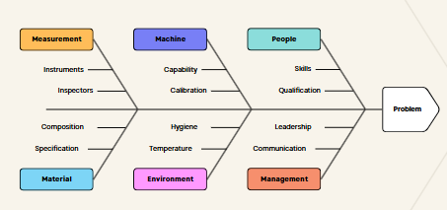
“Common Supply Chain Challenges”
3. Business Knowledge
Inventory Discrepancies Challenge:
Delayed Shipments Challenge:
Quality Defects Challenge:
Supplier Reliability Issues Challenge:
Forecasting Errors Challenge:
Solution :
The above challenges can be addressed by Root Cause Analysis (RCA)

Slide 15
“Case Studies: RCA in Action”
3. Business Knowledge
Case Study 1: Automotive Manufacturer Tackles Supplier Delays
Problem: A major automotive manufacturer faced frequent delays from a key supplier.
RCA Approach: Using Fishbone Diagrams, the team identified inadequate supplier capacity as the root cause.
Solution: They implemented joint capacity planning and invested in supplier training.
Result: Lead times improved by 30%, and production schedules stabilized.
Case Study 2: Retailer Resolves Stockouts
Problem: A global retailer experienced frequent stockouts during peak seasons.
RCA Approach: Through 5 Whys analysis, they discovered that inaccurate demand forecasts were to blame.
Solution: They upgraded forecasting tools and established regular collaboration with suppliers.
Result : Stockout rates decreased by 20%, and customer satisfaction improved.

Slide 16
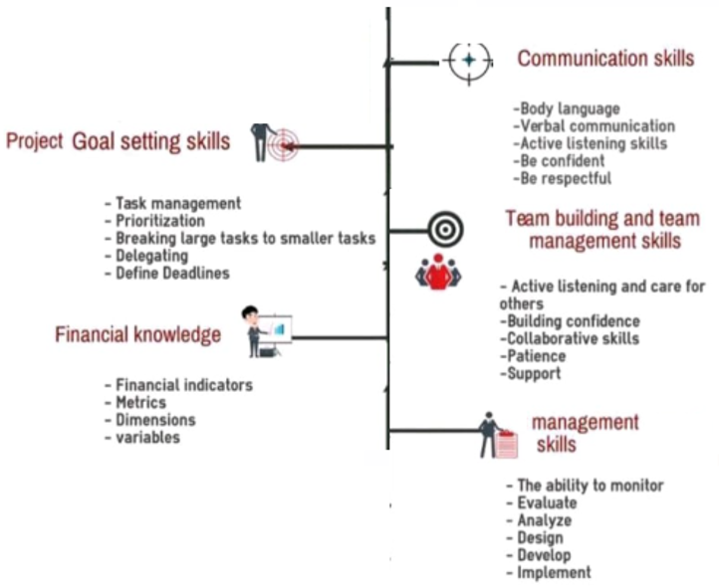
4. Project Management Skills

Slide 17
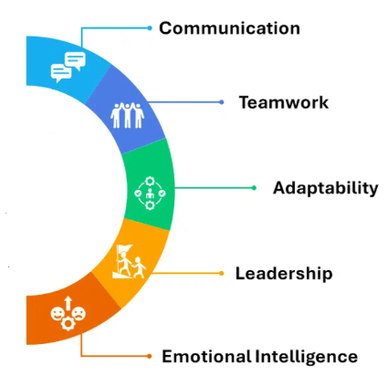
5. Communication / Soft Skills
Attention to Detail: Ensuring accuracy and consistency in data analysis.
Adaptability: Staying updated with the latest tools and trends in analytics.
Teamwork: Collaborating effectively in team environments.
Curiosity: A drive to explore data and uncover hidden insights.

Slide 18


